Slide 1
Understanding DSM obstacles – the evidence
European Consumer Consultative Group meeting
24-25 March 2015
Dan Dionisie, Consumer Markets (E1), DG Justice and Consumers

Slide 2
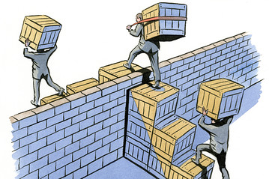
What do we need to know?
Logic:
Removing obstacles (not regulating supply, demand)
Win-win
Market features:
Online cross-border B2C trade flows
supply side: e.g. costs, barriers, commercial strategies
demand side: e.g. trust, concerns, home bias
role of intermediaries: comparison tools, platforms
Obstacles:
supply side / demand side
relative importance, sequencing, combined impact

Slide 3
What do we know?

Slide 4
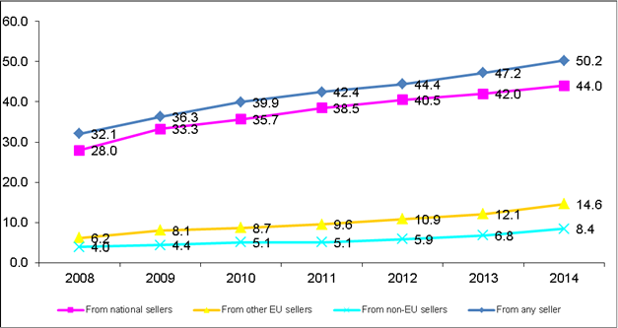
Online B2C flows
growing B2C e-commerce (352-363Bn€ in 2013, +17%, 2.2%GDP, 2m+ jobs, Europe world's leading market ~ 33%)
cross-border potential remains largely untapped (11.7Bn€/year can be saved shopping cross-border; potentially up to 204Bn€ in consumer welfare gains from e-commerce in goods; 260Bn€ overall gains to EU economy achievable in coming years)
cross-border shoppers' total online spending (domestic+CB) is 2x that of domestic only shoppers
…Open question: How to benchmark the DSM performance?
% of EU consumers buying online (past 12 months)

Slide 5
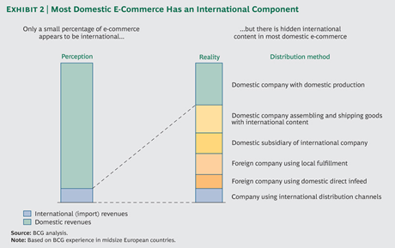
Online B2C flows – some caveats
Consumers may under-report cross-border purchases
Cross-border as credible alternative more important than actual incidence of purchases

Slide 6
Digital products
31% of EU online shoppers bought digital content in 2014
In 2016, 67% of global spending on entertainment and media growth will be generated by digital spending
EU app economy ~17.5 Bn€ (2013; est.63Bn by 2018), 1m jobs, global leader on games apps
Availability of digital content across EU is high: 75-80% for music (iTunes), lower for film… but strong consumer home bias +common preference for English
Online games one of the fastest growing markets, followed by digital music; market for e-books smaller and turnover growing much more slowly.
"Freemium" model influential for games, digital music, online video
Problems reported by 54% of respondents, e.g. no or unclear information (42% of the two most recent problems); problems with access to (31%), the quality (14%) and the security (9%) of the products.

Slide 7
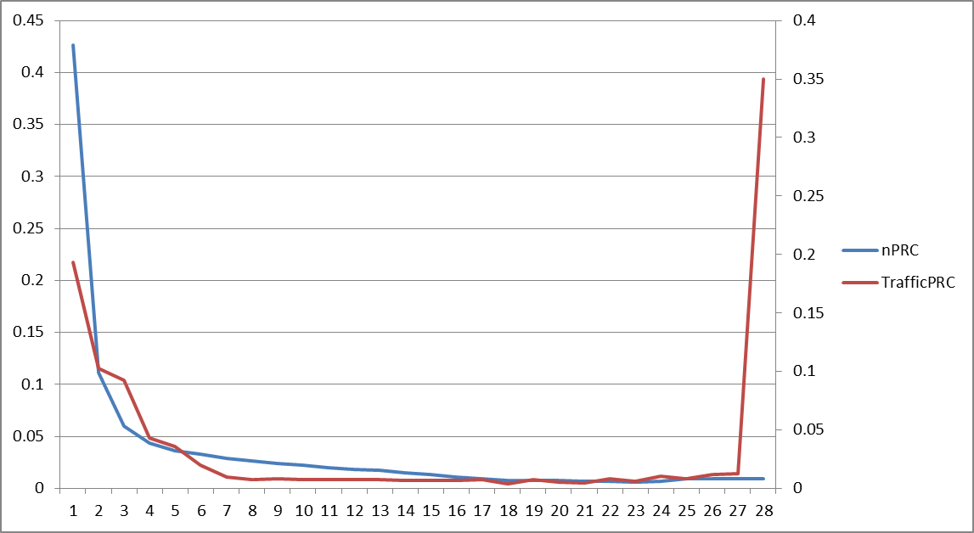
Concentration
Google and Facebook dominate global mobile ad revenues
80% of traffic on <3% of websites = global platforms
App developers squeezed by US-based platforms through high fees
Number of EU28 MS where websites are used: % of website (left), % of page views (right) in EU28

Slide 8
Obstacles as experienced by consumers
Persistent trust gap: consumers more confident making domestic online purchases (61%) than from other EU countries (38%)
Market segmentation by companies:
impossibility of completing a purchase: 10% say foreign seller refused to deliver to their country; 8% were redirected to a website in their own country where prices were different; 5% report that retailer did not accept payment from their country (2014)
74% of the complaints concerning services received by ECC's related to consumers facing difference in price or service when buying online cross-border (2010-12)

Slide 9
Obstacles as experienced by businesses
Retailers that sell online cross-border quote as main barriers to selling to other EU countries:
higher fraud and non-payment risks (42,7%)
differences in national contract law (38,8%)
differences in tax (38,6%)
differences in consumer protection rules (38,4%)
costs involved in resolving complaints and disputes cross-border (35,2%)
transport costs due to distance (34,6%)
Failed intra-EU trade due to contract law: 26-184 Bn€ (2011)

Slide 10
Fresh evidence
In-depth surveys of businesses and consumers to rank DSM obstacles (2015)
Regulatory fragmentation and compliance costs
Trust and security in online transactions
Territorial or vertical restrictions
Access to infrastructure and digital resources
Consumer survey
Tangible goods & services / digital content / online services
Digital content: paid vs. free, downloaded vs. streamed
Reasons for buying, trust, concerns, problems
Purchasing journey
Complemented with clickstream data (actual online behaviour)
Behavioural study on online Terms and Conditions (early 2016)

Slide 11
Surveys on DSM obstacles - initial findings
Business survey
A limited number of barriers really matter, e.g. settling cross-border disputes, suppliers’ restrictions to sell cross-border, delivery costs, taxation rules, and knowledge of “the rules” abroad.
These barriers matter most for small firms who find it harder to overcome the associated trade costs.
Consumer survey
Concerns on cross-border purchases mostly relate to delivery and remedies
Problems experienced mainly on delivery, non-conformity, remedies
Consumers in EU13 spend proportionally more cross-border than EU15
Analysis still ongoing – will feed into DSM Strategy
Consumer survey findings will be reported more extensively in the next Consumer Conditions Scoreboard (Sept. 2015)

Slide 12
Some (still) open questions
How will the benefits of removing contract law obstacles be distributed?
Business vs consumers?
Small business vs big business?
Consumers in smaller markets / poorer countries vs consumers in bigger markets / more affluent countries?
Looking forward to your views, insights, evidence

Slide 13
Thank you!

