Slide 1
Undesirable substances in cosmetics “QuelCosmetic”, an app to make easy choices
European Consumer Consultative Group ECCG
23 & 24 October 2018

Slide 2
WHY THIS PROJECT?
2 years’ project running since 2016
Objectives:
Help consumers in their decision purchase & guarantee safe products.
Particular attention given to vulnerable consumers (children, pregnant women…)
Clarify the message related to undesirable substances
Give consumers practical tools → Active participation

Slide 3
Where do we come from?
1st campaign in February 2016
Daily cosmetics (Moisturizing creams, shampoo, deodorants, toilet waters, wipes…)
185 products containing substances of concern due to their toxicity, allergenicity, irritability or endocrine disruptor.
Famous brands and pharmaceutical products on an equal footing with retailers brands
137 000 sales

Slide 4
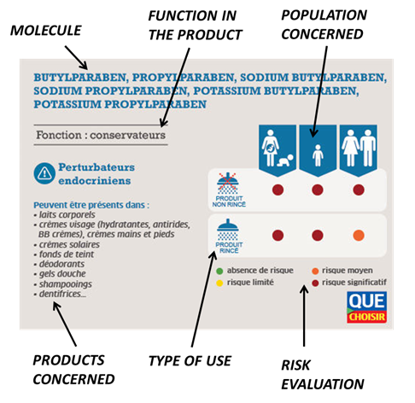
UNDERSTAND
TAKE ACTION
Technical Sheets
Database of products
Dowload the reference map
drag it into your wallet to track the most harmful compounds.
It will help you in your choice of cosmetics and hygiene products for the whole family.
Report Online
Any cosmetic products (hygiene, beauty, make-up) purchased either in specialized stores, pharmacies or supermarkets.
If any of these products contain substances at risk, complete the online form. After verification, we will add them to our list of cosmetic products in which we have identified one or more undesirable ingredients (irritants, allergens, endocrine disruptors).

Slide 5
One year after – UPDATE 2017
Enrichment of the database (doubled): analysis of 400 daily cosmetics (after june communication: 1000)
→ Consumers play the game!
90% of the formulas are unchanged
→ Still work to do!
Online Chat - 1st March 2017 17:00 – 20:00
More than 450 questions (including 136 live)
114 questions answered (119 answers posted)
Nearly 730 people joined the chat
→ Positive experience especially on what interests people

Slide 6
2018 - Launch of QuelCosmetic
Launch on 12th March 2018 with a database of 6000 products: facial, body, hair, baby products, solar, dental hygiene, make-up, perfume…
Financed by UFC-Que Choisir’s endowment fund
Functionalities:
by scanning the bar code of a product or by searching for it by name, the application immediately informs about the presence or absence of unwanted substances and their level of dangerousness depending on the profile: pregnant woman / baby, child / adolescent or adult.
Thanks to the app a better choice is always possible: To meet the expectations of consumers, the app offers a positive list of products that do not contain undesirable ingredients. These are not necessarily the most expensive, so private label cosmetics are often well placed, such as body and facial care products at Lidl and Auchan, which currently account for 86 % and 82% of products without risks.
A participatory app: If the scanned product is not yet in the database, the consumer is invited to report it himself very simply and also has the opportunity to be notified quickly by email of the result of the analysis of the product by the teams of the UFC-Que Choisir.
In practice

Slide 7
1 →E.g., here the risk associated to the use of the product is « significant » for babies and pregnant women.
What does it look like? (1)
2 → More info on the reason why it is so is available by a simple clic on the red symbol ; here « triclosan » is the ennemy.
3 → You clic on the substance and you get an explanation of its nocivity.
Notes:
Example with a very popular toothpaste

Slide 8
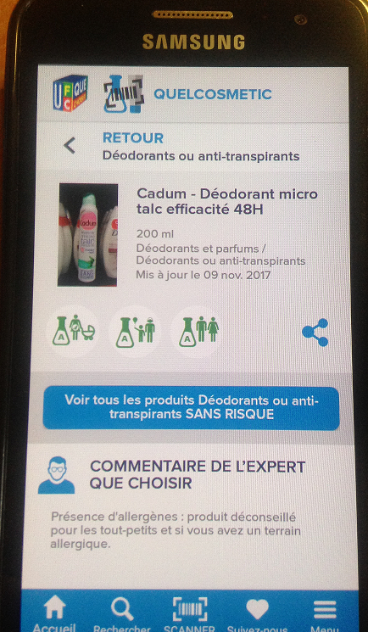
- A clic on « produits sans risque » and the app provides a positive list of products, free of unwanted substances.
What does it look like? (2)
- Initial development of the app allows the presence of allergens* in the group of good products * the ones coming from perfumes, 26 allergens to be declared on the labelling when present above a certain amount

Slide 9
Figures / Success
Downloads 793 000 in Sept 2019 (483 000 iOS, 310 000 Android) compared to ≈ 300 000 in April 2018
Database: Nearly 123 000 products today compared to 48 000 in April 2018 and to 6000 cosmetics at the launch of the app
Google Play score : 4,5/5 (10 000 scores)
App store score : 4,6/5 (11 300 scores)
On the 5 first weeks after the official communication of the 12th March: the app generates a trafic of 1.4 millions visits
Public authorities’interest: ECHA (« exports » of the DB on siloxanes and microplastics for preparation of restriction dossiers)

Slide 10
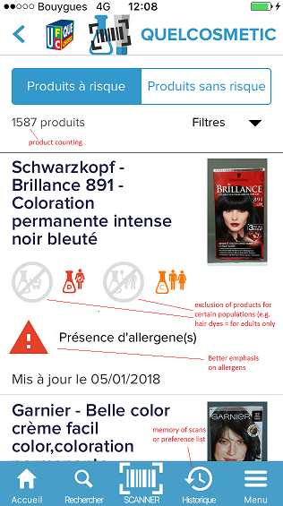
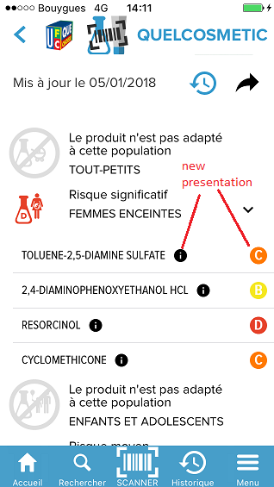
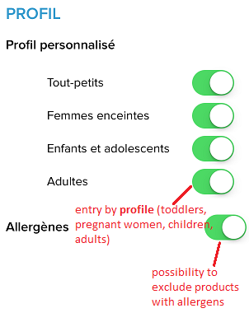
To come: Launch of V2 - 20th Oct 2018
New functionalities

Slide 11
THANK YOU FOR YOUR ATTENTION
Karine DE CRESCENZO
kdcrescenzo@quechoisir.org
+33 (0)1.44.93.18.89

