Slide 1
The Commission’s NPL Package and the Directive on Credit Servicers, Credit Purchasers and Collateral Recovery

Slide 2
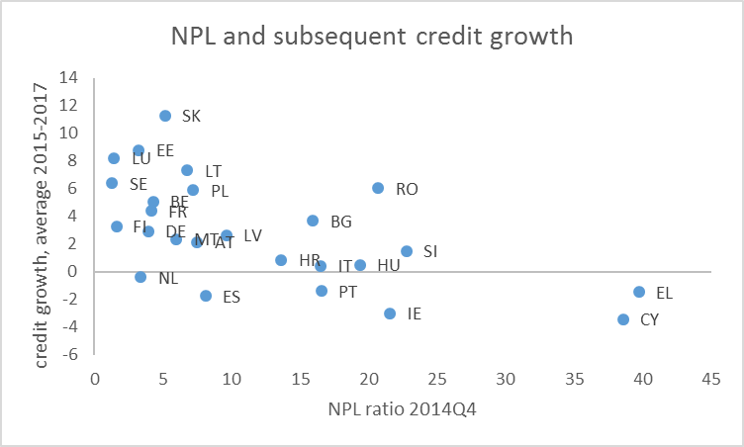
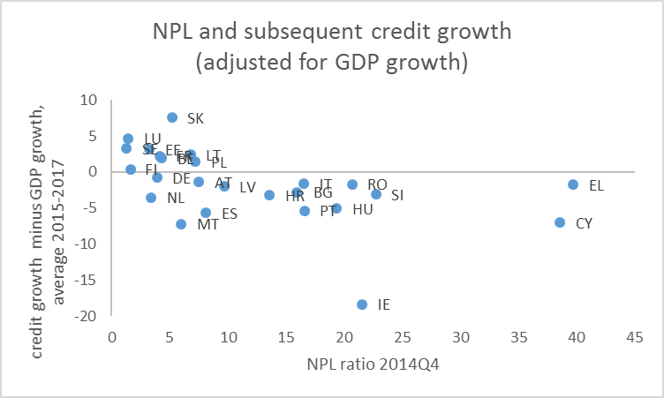
Non-performing loans as impediment to bank lending and economic recovery
Member States with high NPL had weaker bank lending (even when different GDP growth is accounted for)
Banks with high NPL have difficulties to obtain capital and funding

Slide 3
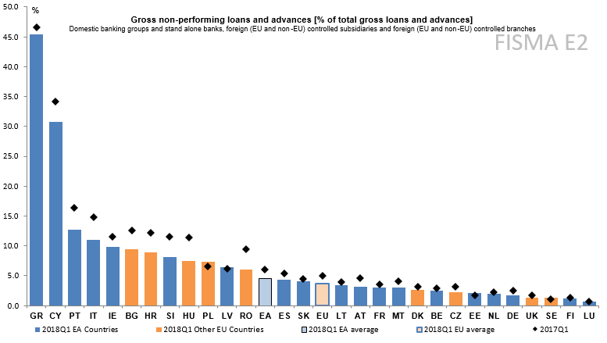
NPLs: Declining but still high
Non-performing loans (NPLs) are one of the remaining legacy risks in the European banking system.
Despite the significant progress already made, NPLs continue to pose risks to economic growth and financial stability.

Slide 4
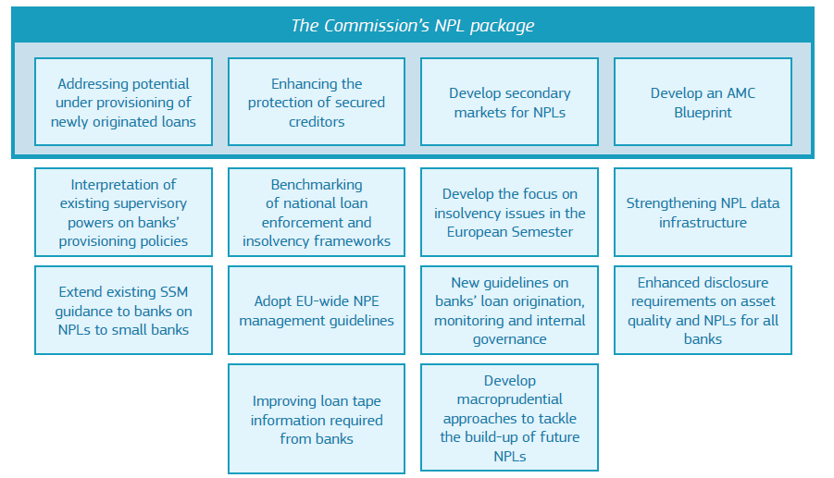
The Council’s NPL Action Plan
Mandates tasks to COM, EBA, ECA, ESRB and Member States
Includes push and pull-factors.
Notes:
Enhanced protection of secured creditors: in a manner complementary to the proposal on preventive restructuring procedures, second chance for entrepreneurs, and the efficiency of insolvency frameworks put forward in November 2016.

Slide 5
The Commission’s NPL package
Based on the Council Action Plan to Tackle NPLs, the Commission put forward a comprehensive package of measures that will speed up the reduction of NPLs in Europe.
It will create the appropriate environment for dealing with current NPLs and reduce the risk of future NPL accumulation.
The proposed actions will enable banks and Member States to address NPLs in a more determined way than before.

Slide 6
Elements of the NPL package
The package consists of two legislative proposals and a staff working document providing non-binding technical guidance (a so-called ‘blueprint’) for how national Asset Management Companies (AMCs) can be set up by Member States, if they so wish.
Together, these proposals will:
enhance the prudential tools needed to effectively address NPLs;
encourage the development of secondary markets for NPLs;
facilitate debt recovery by enhancing the protection of secured creditors in an extrajudicial proceeding; and
[assist Member States – that so wish – in the restructuring of their banks by establishing AMCs dealing with NPLs.]
Notes:
Enhanced protection of secured creditors: in a manner complementary to the proposal on preventive restructuring procedures, second chance for entrepreneurs, and the efficiency of insolvency frameworks put forward in November 2016.

Slide 7
Statutory prudential backstop
What?
Measure to ensure sufficient loss coverage by banks for future NPLs
Instrument:
A Regulation amending the Capital Requirements Regulation (CRR)
Objective:
To introduce common minimum coverage levels for newly originated loans that become non-performing.
The minimum coverage levels will act as a statutory prudential backstop. The measure addresses the risk of not having enough money to cover losses on future NPLs and prevents their accumulation.

Slide 8
Secondary markets for NPLs: economic effects

Slide 9
Content of the Directive
What?
To improve the conditions for market entry for NPL buyers and loan servicing firms.
Instrument:
Directive on credit servicers, credit purchasers and the recovery of collateral
Objective:
The proposal defines the activities of credit servicers, sets common standards for authorisation and supervision, and imposes conduct rules across the EU. As such, the proposal facilitates cross-border activities.
The proposal does not affect contract law principles under national law
Consumer protection is ensured by legal safeguards and transparency rules so that the transfer of a loan does not affect the rights and interest of the borrower.

Slide 10
Access to the European NPL market
What changes?
No authorisation for credit purchasers in any Member State but authorities are informed of the transfer.
Authorisation for credit servicers; can passport their services across the EU.
Third-country purchasers to appoint a legal representative in the EU.
Safeguards for borrowers
All legal protections applied to the bank loan remain in place.
Proportionate supervision incentivises credit purchasers and servicers to treat borrowers fairly.
Authorisation of credit servicers based on fit-and-proper criteria.
Third-country purchasers of consumer loans to have them serviced by an authorised EU credit servicer or by a bank.

Slide 11
Collateral enforcement: economic effects

Slide 12
Accelerated extrajudicial collateral enforcement
What?
Measure to provide more efficient value recovery from secured loans
Instrument:
Directive on credit servicers, credit purchasers and the recovery of collateral
Objective:
To provide secured creditors with an efficient mechanism, based on and requiring upfront contractual agreement, for out-of-court value recovery from collateral.
If the borrower defaults on the loan, such accelerated extrajudicial collateral enforcement will allow creditors to enforce the collateral securing the loan in an expedited way, without going to court.
Strictly limited to loans granted to businesses: Consumer loans are excluded. Various safeguards for the borrower ensure a balanced mechanism.

Slide 13
Accelerated extrajudicial collateral enforcement: Safeguards
Consumer loans excluded;
Borrower’s first residences excluded;
Only upon upfront agreement between creditor and borrower;
Rules on fair valuation;
Borrower can challenge the use of the mechanism in court;
Excess proceeds to be turned over to the borrower; and
Member States may put in place a rule that even where the proceeds from the collateral fall short of the amount outstanding on the loan, the loan shall be considered fully settled.

Slide 14
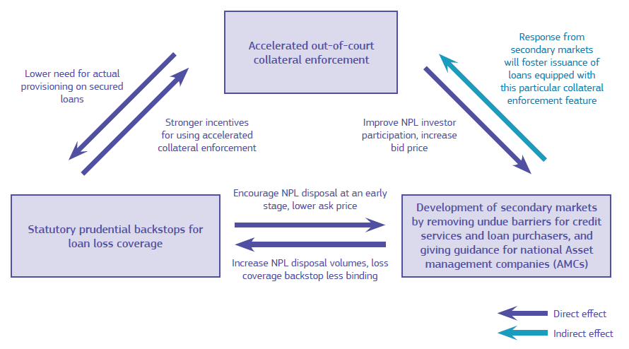
A strong package with mutually reinforcing measures
The proposals would not be as effective if implemented in isolation

Slide 15
AMC Blueprint
What?
A technical guidance for how national AMCs can be set up
Instrument:
Staff working document
➔ non-binding, non-legislative
Objective:
To guide Member States on how they can set up national AMCs, should they find it useful, in full compliance with EU banking and State aid rules. Setting up an AMC is voluntary.
While considering AMCs with a State aid element as an exceptional solution, the blueprint clarifies the permissible design of AMCs, if receiving public support.
The blueprint suggests a number of common principles, on the set-up, governance and operations of AMCs. The blueprint draws on experience and best practices from AMCs already set up in Member States.

Slide 16
Conclusion
NPLs are still an important challenge for the European banking system. The total volume of NPLs across the EU remains well above pre-crisis levels.
Tackling this issue is supported by the economic recovery. Yet more is needed.
The Commission therefore launched a comprehensive package of “push” and “pull” measures to address the NPL challenge.
As Europe and its economy regain strength, we must seize the momentum and further reduce risks in the banking sector, accelerating the reduction of NPLs as well as preventing future build-ups of NPLs.

